Slide 1
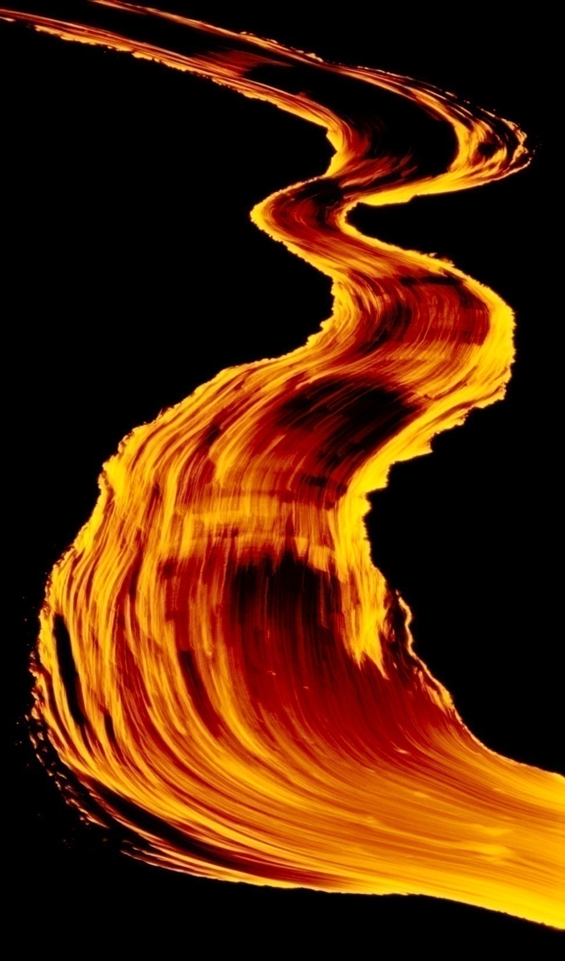
Volcanic Features
Vent collapse and/or erosion
Pyroclastic eruptions
Lava flows and related features
Vents
Lava tubes
Lava types (chaos theory)
Notes:
We have arrived now at the last topic related to lava – lava types. Although there are fundamentally only two types of basaltic lava, the variety of forms these can develop is amazing and provides a beautiful example of chaos theory applied to natural systems.

Slide 2
The iterative application of simple rules
can have complex, unexpected outcomes.
Notes:
Simply stated, chaos theory predicts that the iterative application of simple rules can have complex, unexpected outcomes.

Slide 3
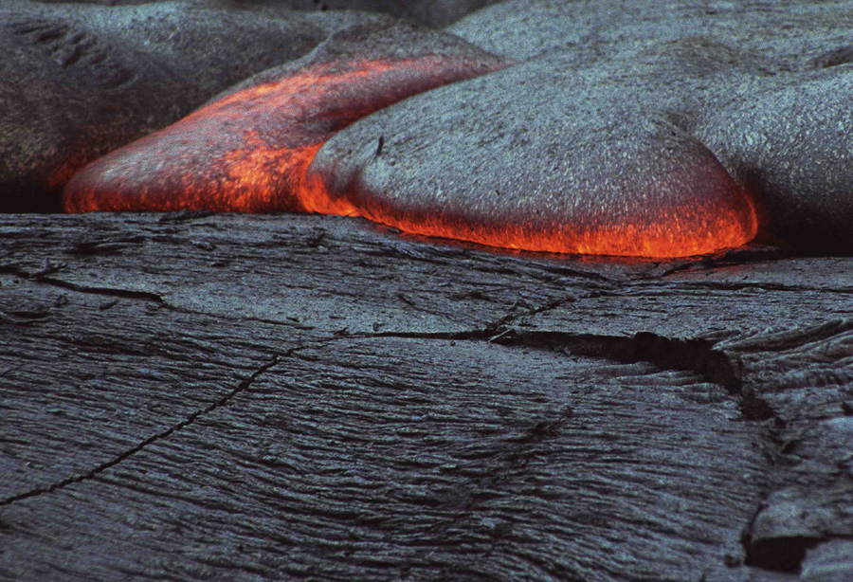
Simple rules control lava behavior:
Gravity
Viscosity
Notes:
The simple rules that control lava behavior are most fundamentally based on gravity and lava viscosity. Gravity provides the force to move the lava, but its ability to do so depends on lava viscosity.

Slide 4
Simple rules control lava behavior:
Gravity (increases with slope angle and lava volume)
Viscosity (decreases with Temp, shear stress, gas content.)
Notes:
Steeper slopes and larger volumes of lava will help gravity move lava down slope, while higher temperatures, lower internal shear stress and higher gas contents will all reduce viscosity and thereby encourage down slope motion. By themselves these parameters do not result in the “complex, unexpected outcomes” predicted by chaos theory, ….

Slide 5
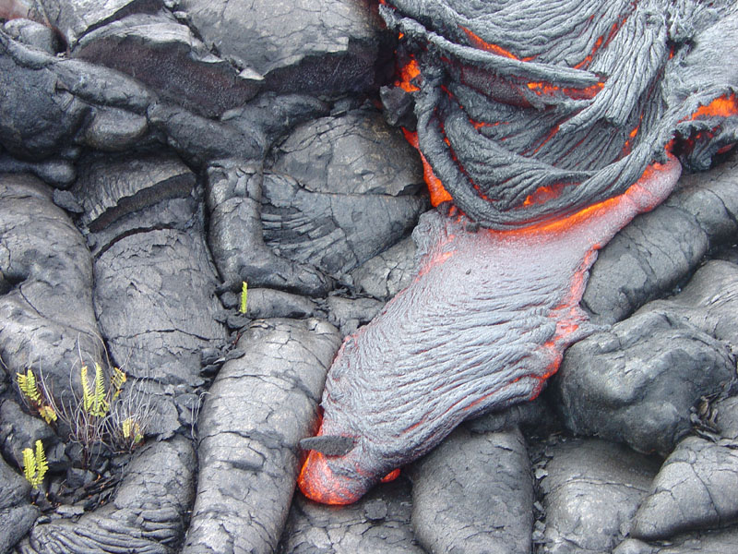
Results become new initial conditions.
feedback
Notes:
… but with lava flows (and many other geologic processes) the outcomes of following simple rules become the new initial conditions from which to reapply the rules. This is where the term iterative (meaning repeated over and over) comes into play, because the results of applying the simple rules creates feedback which constantly affects future outcomes. You can see the principle as work in this pahoehoe lava flow. A tongue of lava pours from the base of an active flow, but its path is affected by previous flows. In this way complex, but not entirely random patterns are developed in the flow.

Slide 6
"Chaos theory is the qualitative study of unstable aperiodic behavior in deterministic nonlinear dynamical systems.“
First, that the system is dynamical, means that it changes over time.
Second, that the behavior of the system is aperiodic and unstable means that it does not repeat itself.
Third, although chaotic behavior is complex, it can have simple causes.
Fourth, because the system is nonlinear, it is, as we have already seen, sensitive to initial conditions. (Nonlinearity means that the output of the system is not proportional to the input and that the system does not conform to the principle of additivity, i.e., it may involve synergistic reactions in which the whole is not equal to the sum of its parts.
Fifth, because the system is deterministic, chaotic behavior is not random even though its aperiodicity and unpredictability may make it appear to be so. On the other hand, because of the instability, aperiodicity, and sensitivity to initial conditions, the behavior of chaotic systems is not predictable even though it is deterministic.
A final feature of chaos, although not included in the above definition, is that of iteration or feedback, in which the output of the system is used as the input in the next calculation.
Notes:
A complete explanation of chaos theory is well beyond the scope of this lesson (and my understanding!), but there’s a nice summary here for the interested reader, …

Slide 7
Conway's Game of Life
http://www.math.com/students/wonders/life/life.html
The iterative application of simple laws can have complex outcomes.
Notes:
… and I encourage you to play around with Conway’s Game of Life where you can see first hand how the iterative application of simple laws can have complex outcomes.

Slide 8
Strange attractor rendered by “Chaoscope”
Notes:
Such complex outcomes can be expressed as mathematically determined patterns known as “strange attractors”. If you would like to explore deeper the fascinating world of chaos theory, I highly recommend downloading “Chaoscope” - the free 3D Strange Attractor rendering software that made all the abstract images seen here.

Slide 9
Strange attractor rendered by “Chaoscope”
Notes:
I’m convinced that if you played around with Chaoscope long enough one could find strange attractors that look like many geologic shapes including pahoehoe and …

Slide 10
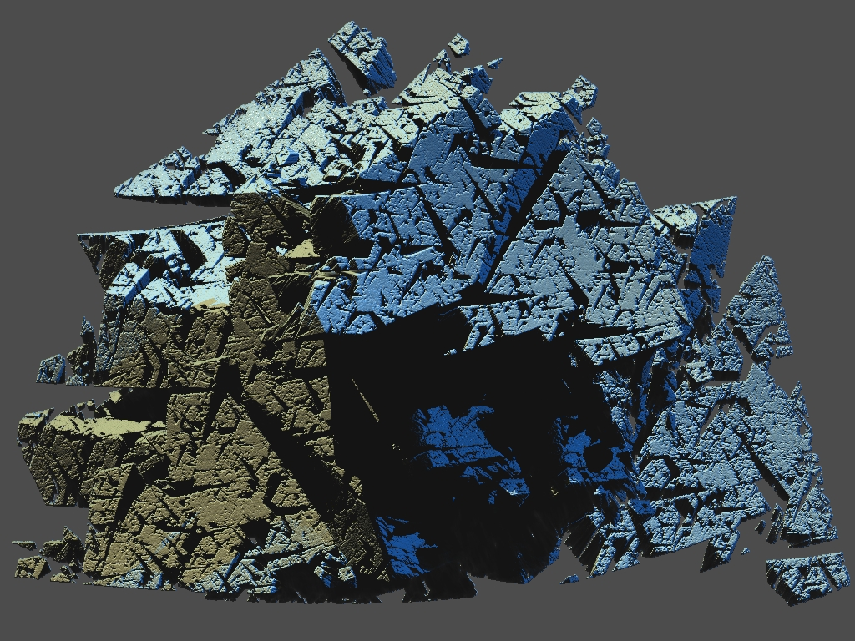
Strange attractor rendered by “Chaoscope”
Notes:
… aa.

Slide 11
Pahoehoe
Notes:
As we move through the various lava types and patterns, try to see them as outcomes predicted by the larger paradigm of chaos theory and perhaps, by extension, you may catch a glimpse of how it applies to other geological phenomena. First up – pahoehoe.

Slide 12
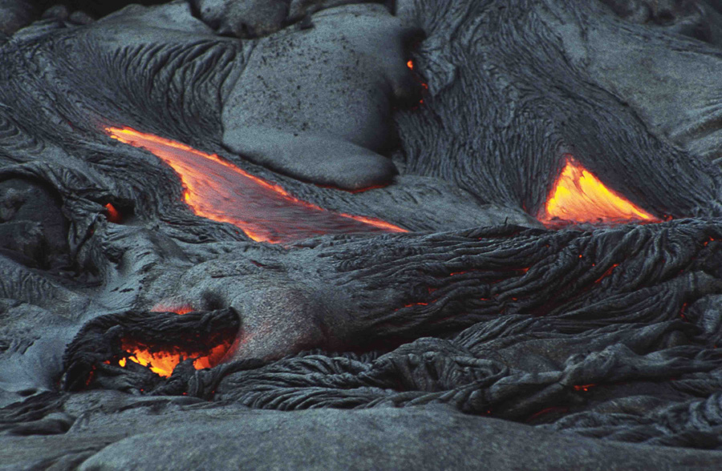
Smooth and ropy pahoehoe
Notes:
Pahoehoe is a Hawaiian term for basaltic lava that has a smooth, hummocky, or ropy surface. The high fluidity (low viscosity) of pahoehoe generally results from its high temperature …

Slide 13
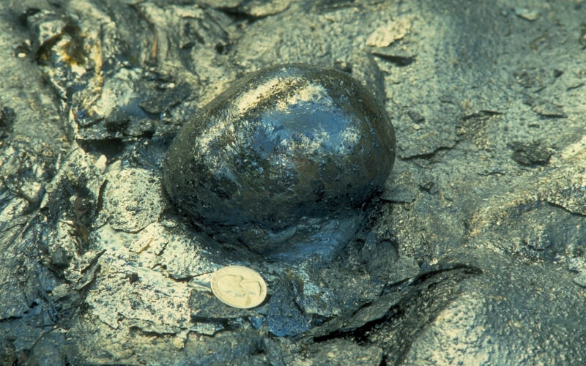
Pahoehoe blister
Notes:
…and high gas content as is evident from this blister on the surface of a pahoehoe flow. Blisters are thin-walled basaltic-glass bubbles formed by the release of volcanic gas from the surface of a pahoehoe flow. Like a glass blower that blows air into molten glass to create a goblet or vase, gas released from lava may force the thin glassy crust of a lava flow to form a large bubble or blister. They are found on all types of pahoehoe flows.

Slide 14
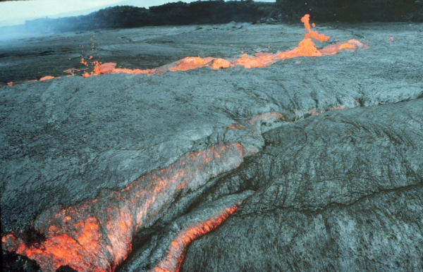
Shelly pahoehoe
Notes:
The most gas-rich, high temperature lava is generally confined to near vent regions and forms a type of lava called shelly pahoehoe. Often this form occurs with overflows from a near vent lava lake, as volumes of gas rich lava pours over confining dikes. As this lava flows down slope it forms huge knaps and rolls covered by a thin, frothy surface skin of basaltic “foam”.

Slide 15
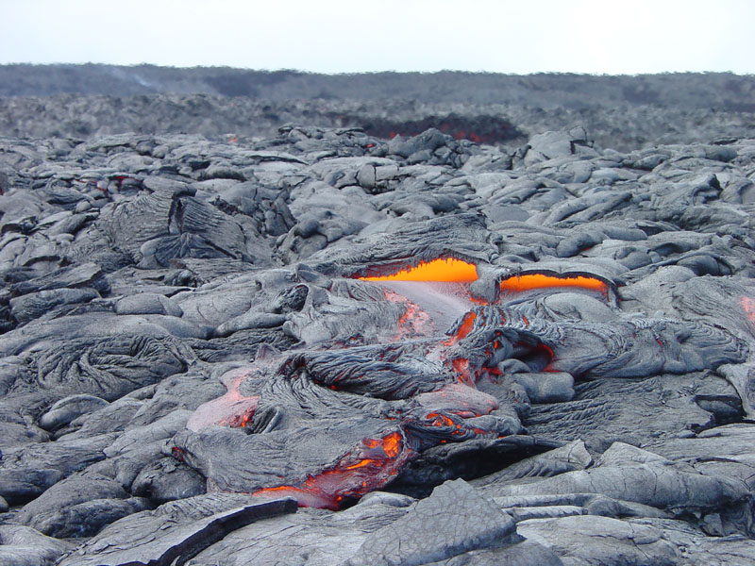
Notes:
Lava may drain out from beneath the solidified froth, …

Slide 16
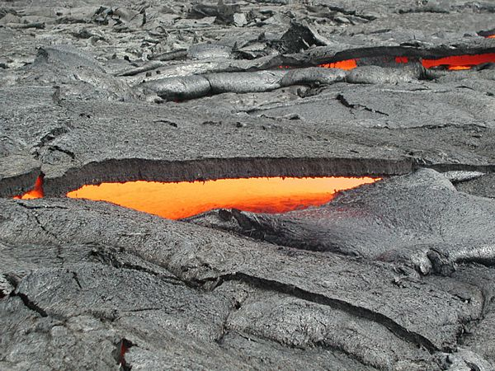
Shelly pahoehoe
Notes:
… leaving shelly surfaces that often collapse when walking on the top of the flow.

Slide 17
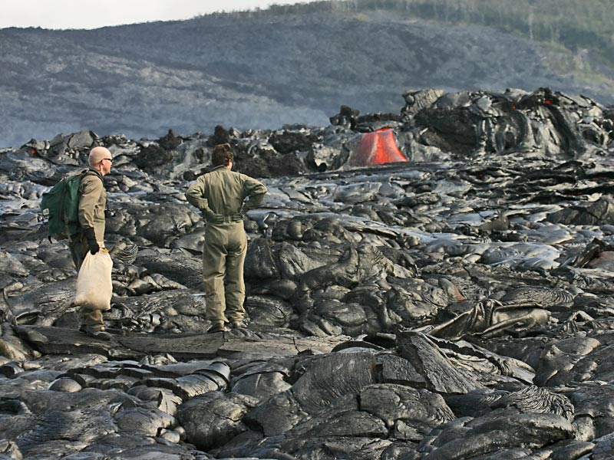
Notes:
You wouldn’t want to walk across shelly pahoehoe while there is still lava inside! These volcanologists look like they are having second thoughts.

Slide 18
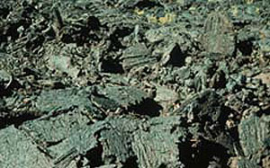
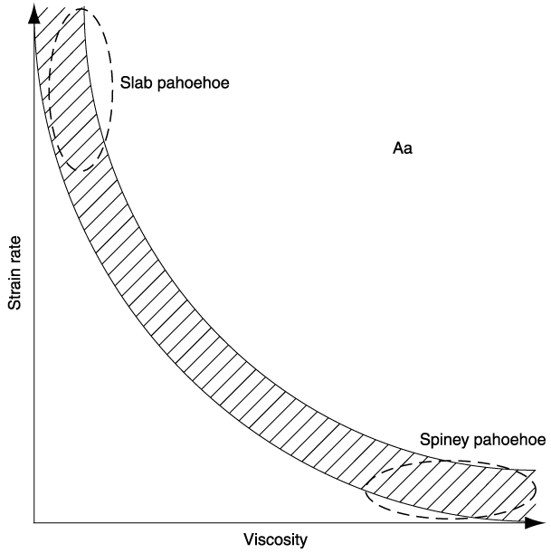
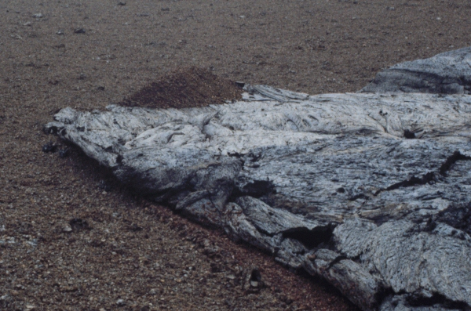
Slab pahoehoe
aa
pahoehoe
Notes:
Slab pahoehoe has a surface that consists of a jumbled arrangement of jagged plates, or slabs, of pahoehoe that were rafted, sheared, tilted, upturned, overturned and heaped on each other. Slab pahoehoe is also somewhat common in the near vent region, though perhaps not as common as shelly pahoehoe. Slab pahoehoe is the result of fluid lava subjected to high strain rates, although I must admit I could not determine where that strain comes from.

Slide 19
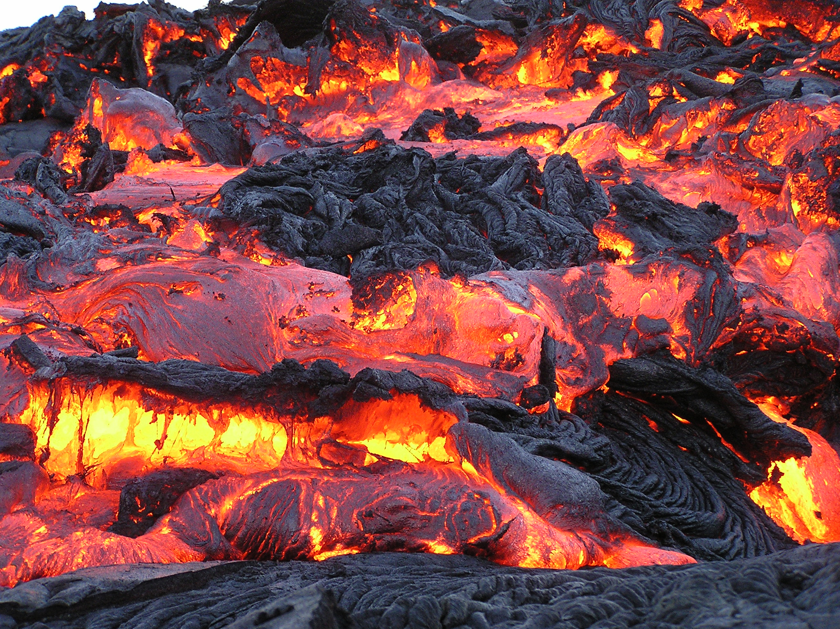
Notes:
I suppose it could be from pouring down steeper slopes near the vent or perhaps from splash-over from especially turbulent lava lakes.

Slide 20
Slab pahoehoe
aa
pahoehoe
Notes:
Slab pahoehoe is a transitional form to aa and will become aa should the lava’s viscosity increase while high strain rates are maintained. For example: if rapid movement continued while slab pahoehoe cooled, it would turn into aa. The mechanics of that transition will be discussed in greater detail when we cover aa.

Slide 21
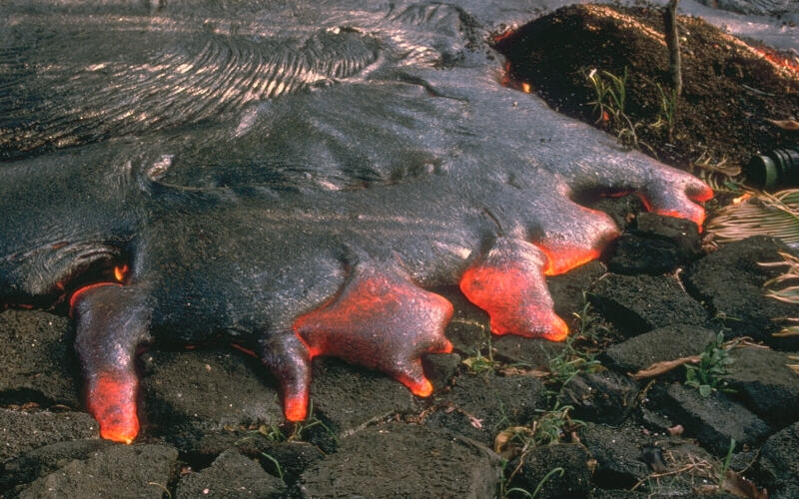
Pahoehoe toes
Notes:
A pahoehoe flow typically advances as a series of small lobes and toes that continually break out from a cooled crust. These small glowing pahoehoe toes were fed by lava that broke out from a lava tube (out of view) at Kilauea Volcano, Hawai`i.

Slide 22
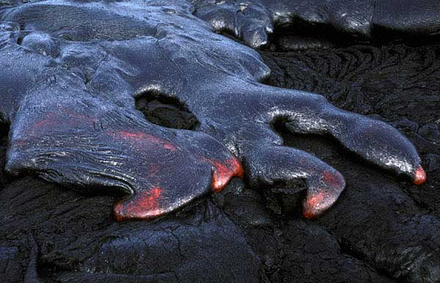
Notes:
The flow spreads as the small toes grow in size and merge together to form a broader front, …

Slide 23
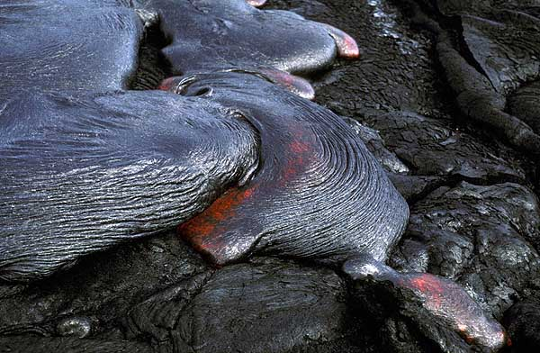
Notes:
… which in turn inflates with new lava moving through the molten core of the flow. Another series of budding toes will break out, move forward, and start the process over again. (Did you catch the iterative aspect of chaos theory there?) Originally it was thought that pahoehoe was emplaced by stacking these toes one on top of another. Although that certainly happens …

Slide 24
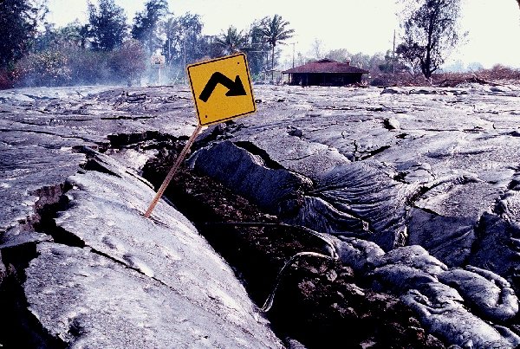
Pahoehoe flows inflated from below
Notes:
… it has become increasingly clear that much of the lava emplaced in massive flow fields is emplaced beneath the surface raising it up. This is evidenced by signs and fence lines plucked from the ground and large flexural cracks resulting from the uplift of adjacent slabs.

Slide 25
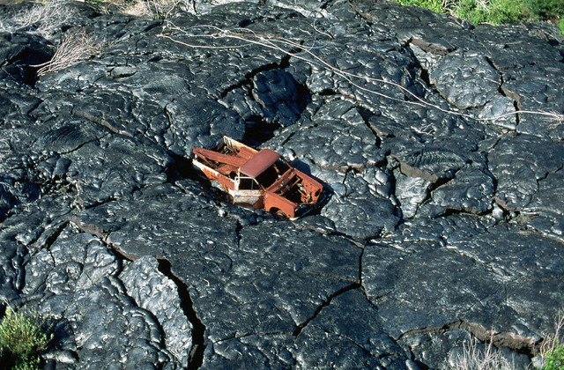
Notes:
This pickup truck that was abandoned to the lava also shows evidence for flow inflation.

Slide 26
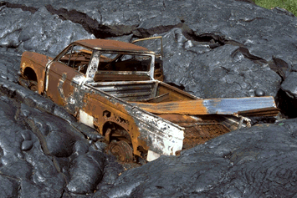
Notes:
Note how the lava flowed around the truck but did not bury it. The truck was then lifted upwards as the flow inflated.

Slide 27
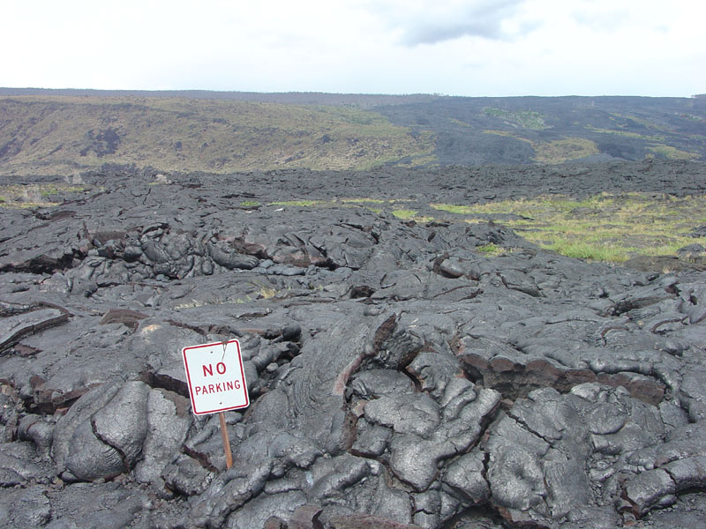
Notes:
Parking violations can have serious consequences in Hawaii Volcanoes National Park.

Slide 28
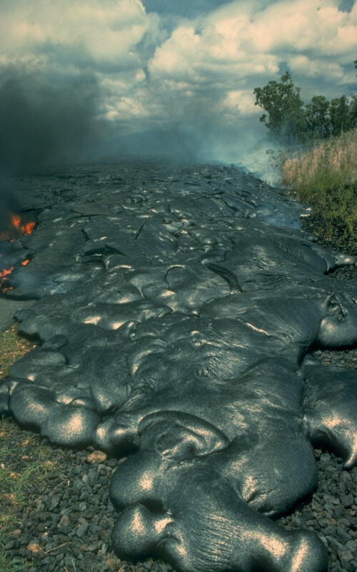
Smooth pahoehoe
Notes:
The surface texture of pahoehoe flows varies widely, displaying all kinds of bizarre shapes often referred to as lava sculpture. This is the smooth variety which generally forms where hot lava has recently broken out of a lava tube and flows across unobstructed, gentle slopes such as this road in Kalapana on the east rift zone of Kilauea Volcano.

Slide 29
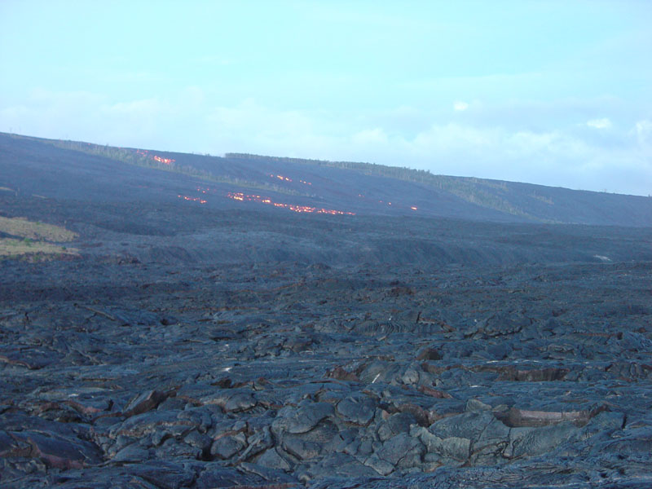
Notes:
When lava flows down steeper slopes …

Slide 30
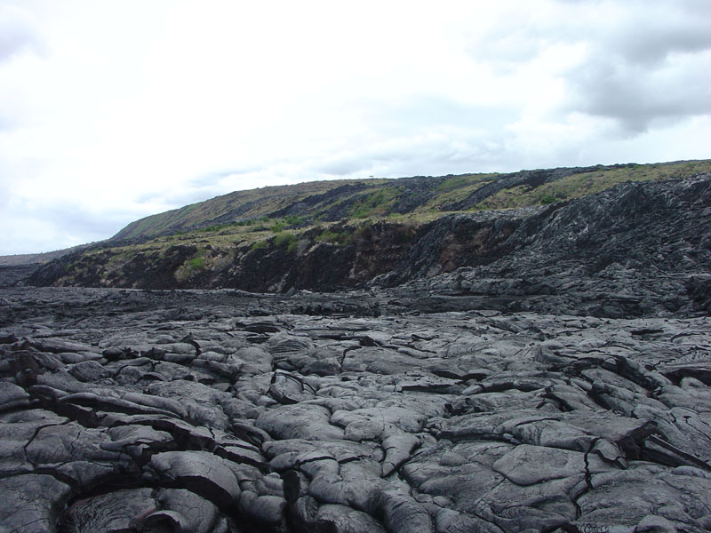
Notes:
… like the great fault scarps on the south flank of Kilauea Volcano ….

Slide 31
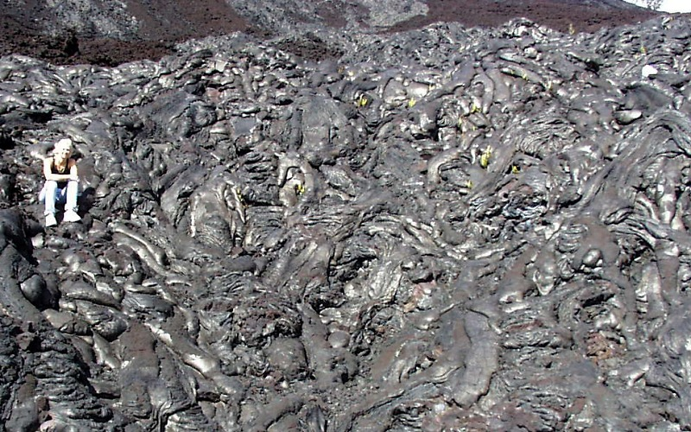
Entrail pahoehoe
Notes:
… an unusual variety of lava is formed called entrail Pahoehoe. Named after the texture of an animal's intestines,

Slide 32
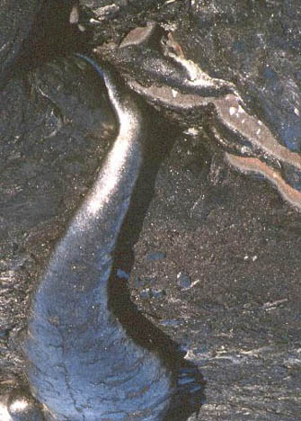
Entrail pahoehoe
Notes:
… entrail pahoehoe is characterized by especially elongated protrusions of pahoehoe resulting from rapid rates of flow relative to solidification.

Slide 33
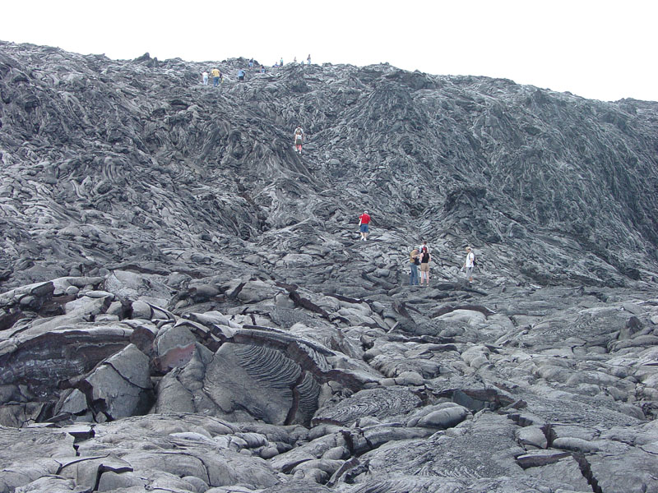
Notes:
On the south flank of Kilauea the most striking examples occur where pahoehoe oozed down steep scarps in the Hilina fault system. Entrail pahoehoe also tends to form on steep slopes because the force of gravity is more effective …

Slide 34
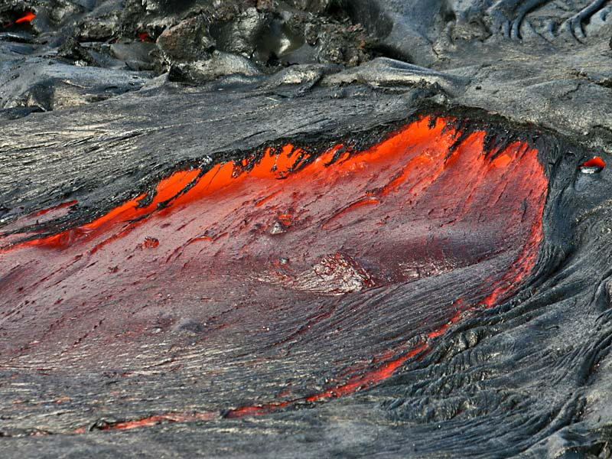
Notes:
in causing lava breakouts, which are necessary to form the multiplicity of long, narrow flows characteristic of entail pahoehoe.

Slide 35
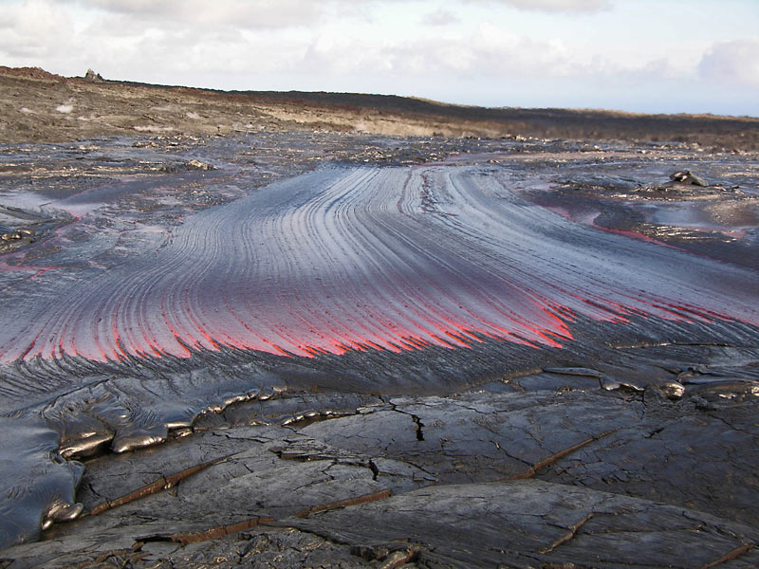
Notes:
Lava breakouts may also occur on nearly flat ground at a bend in a lava tube. Note the rake-like marks left in the very smooth pahoehoe here as it flows from underneath the wrinkled margin of the lava tube.

Slide 36
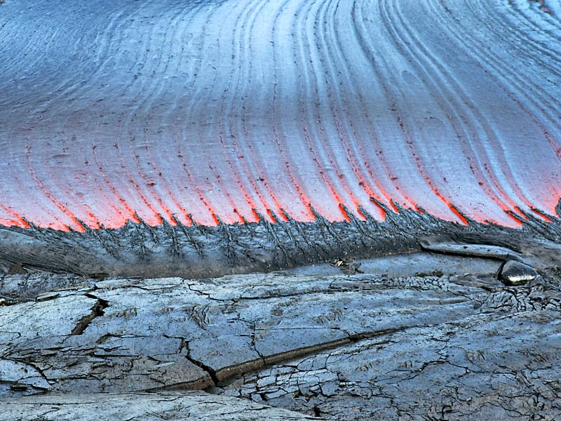
Notes:
A good example of a complex, unexpected outcome from the iterative application of simple rules.

Slide 37
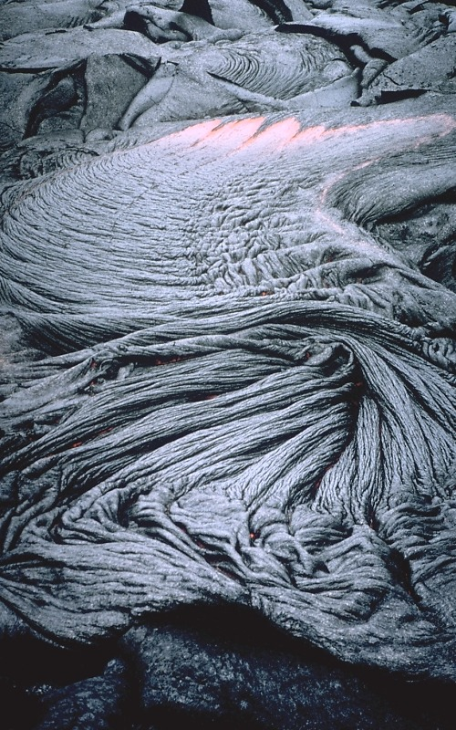
Ropy pahoehoe
Notes:
Ropy pahoehoe is the most common surface texture of pahoehoe flows. The numerous folds and wrinkles ("ropes") that are characteristic of ropy pahoehoe form when the thin, partially solidified crust of a flow is slowed or halted (for example, if the crust encounters an obstruction or slower-moving crust).

Slide 38
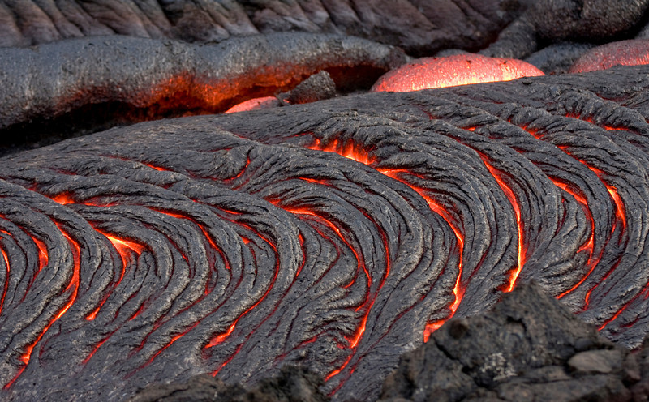
Notes:
Because lava beneath the crust continues to move forward, it tends to drag the crust along. The crust then behaves like an accordion that is squeezed together--the crust is flexible enough to develop wrinkles or a series of small ridges and troughs as it is compressed and driven forward.

Slide 39
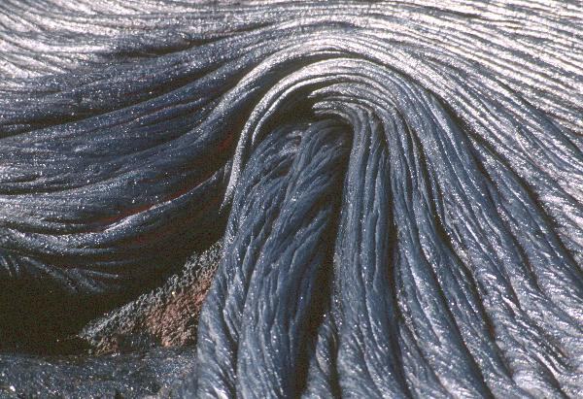
Notes:
Because the shape of the ropy crust is determined by how it interacts with adjacent ropy crust, the iterative prerequisite of chaos theory is in full effect. Forms resembling strange attracters …

Slide 40
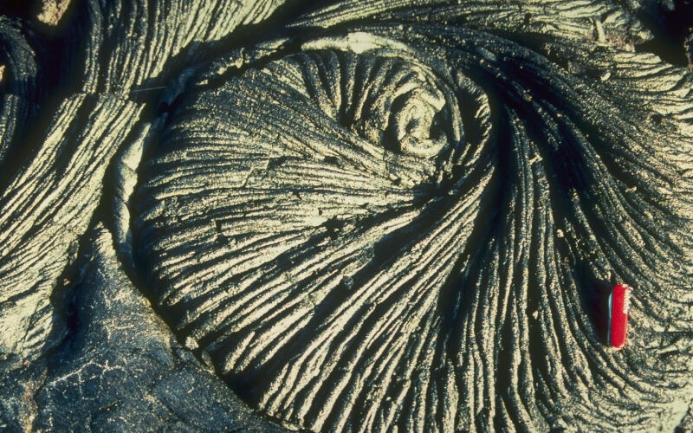
Lava coil on pahoehoe flow
Notes:
… are especially noticeable in ropy pahoehoe. Lava coils like this are spiral or scroll-shaped features that form along slow-moving shear zones in a flow; for example, along the margins of a small channel. The direction of flow can be determined from a lava coil. Lava on the right side of the photo was moving toward the top of the view relative to lava on the left side.

Slide 41
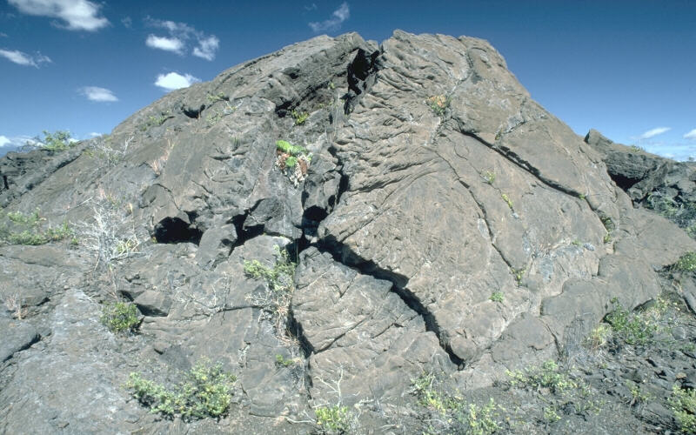
Tumulus
Notes:
Tumuli can be thought of as pahoehoe on steroids. These elliptical, domed structures on surfaces of pahoehoe flows occur on flat or gentle slopes. A tumulus is created when the upward pressure form of slow-moving molten lava within a flow swells or pushes the overlying crust upward. Since the solid crust is brittle, it usually breaks to accommodate the "inflating" core of the flow. Such fractures generally extend along the length of a tumulus, and are frequently accompanied by smaller irregular cracks down the sides.

Slide 42
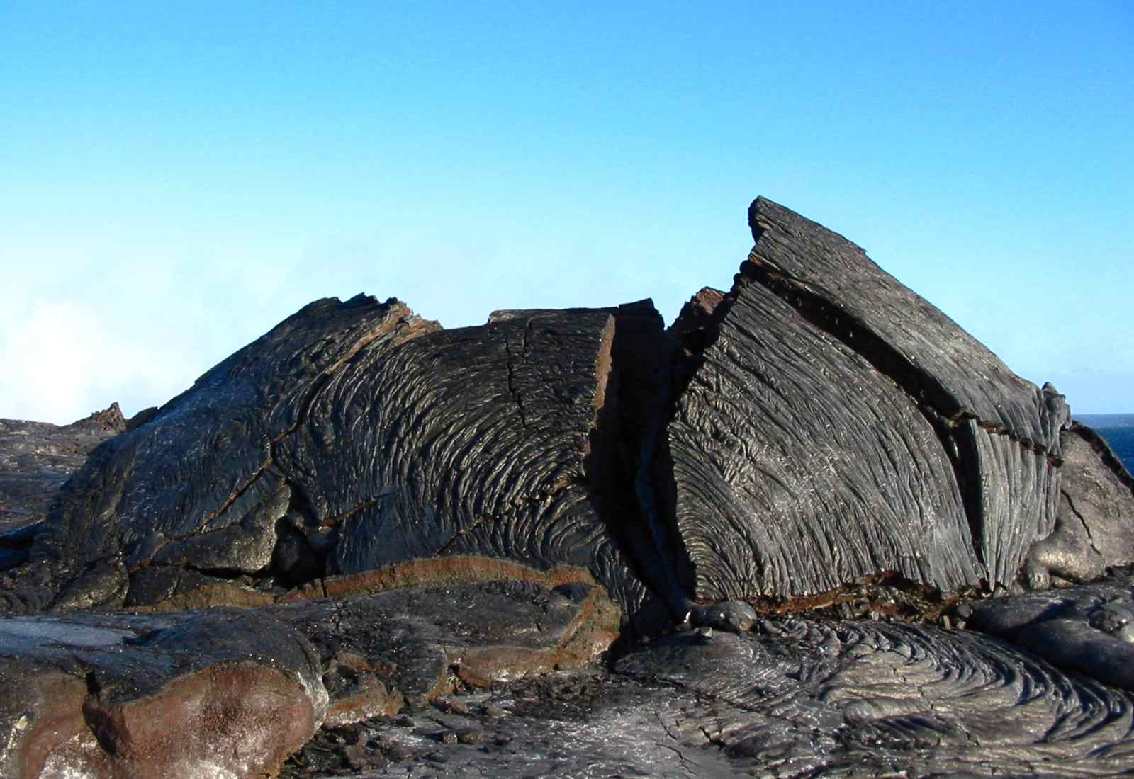
Notes:
Lava commonly squeezes out through these fractures, and sometimes drains from the tumulus to leave a hollow shell.

Slide 43
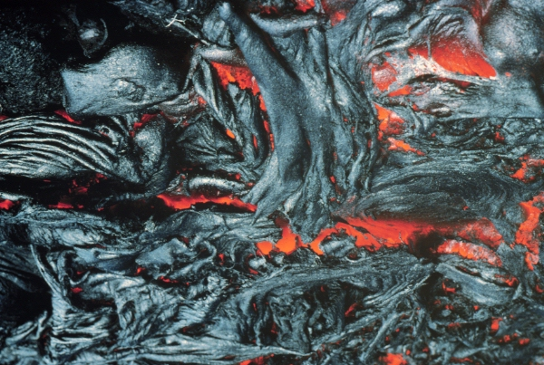
Spiney pahoehoe
aa
pahoehoe
Notes:
Spiney pahoehoe is the most viscous pahoehoe, which with just a little more strain applied (for example flowing over a cliff), can turn into aa. Walking over spiney pahoehoe can be quite unpleasant -- something like walking over an array of swords pointing up with their handles buried in rock.

Slide 44
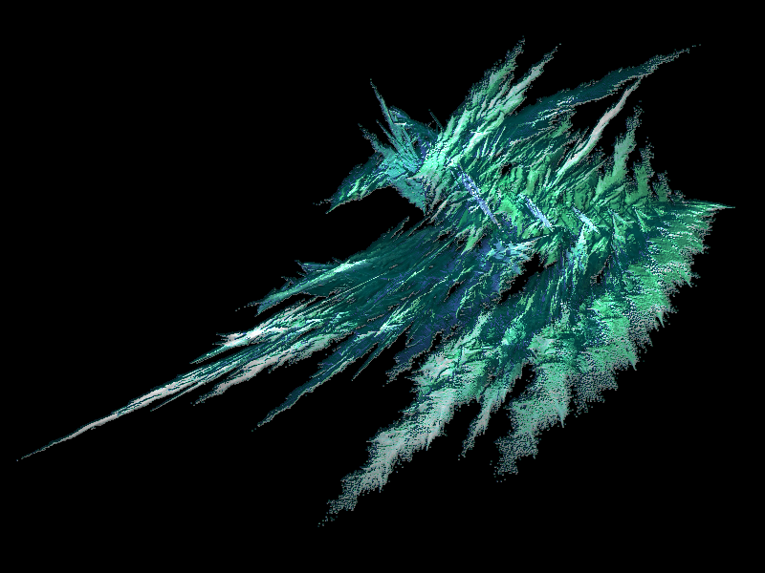
aa
Notes:
Aa is pahoehoe’s edgy cousin.

Slide 45
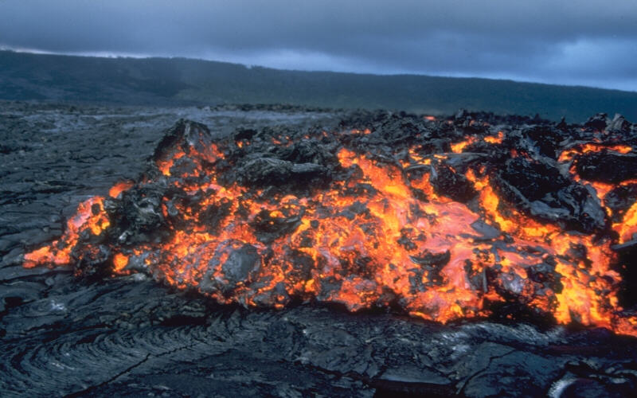
Notes:
The Hawaiian term applies to lava flows that have a rough rubbly surface …

Slide 46
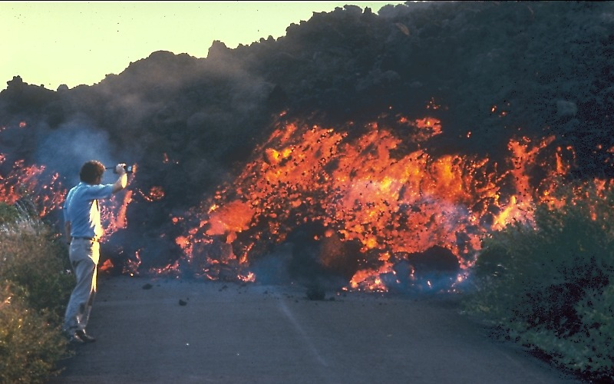
A’a flow from Pu’u O’o in Royal Gardens subdivision 7/2/83
Notes:
… composed of broken lava blocks called clinkers.

Slide 47
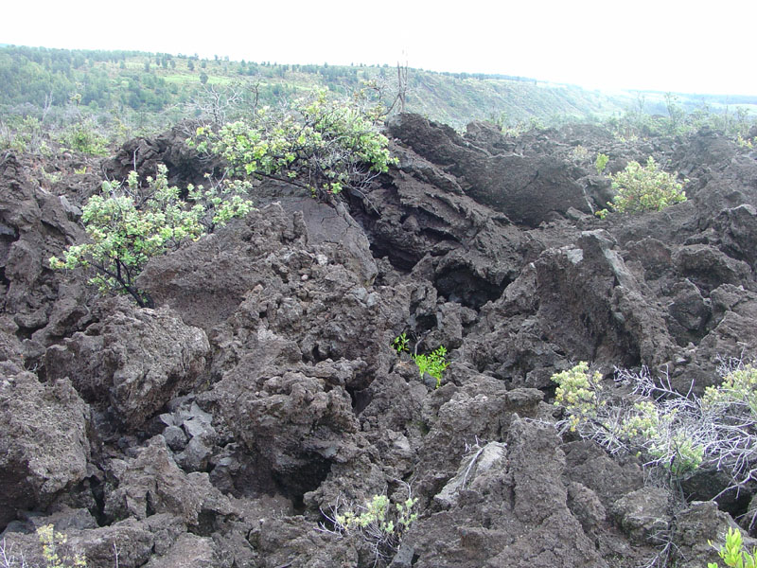
Notes:
The incredibly rough, jagged and even spinose surface of a solidified aa flow makes walking difficult. One might imagine that the term came from the pained vocalizations made by early barefooted Hawaiians.

Slide 48
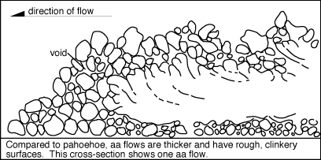
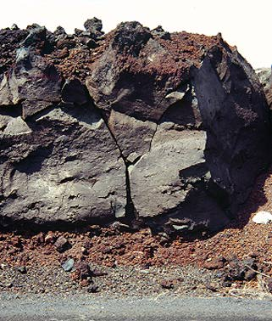
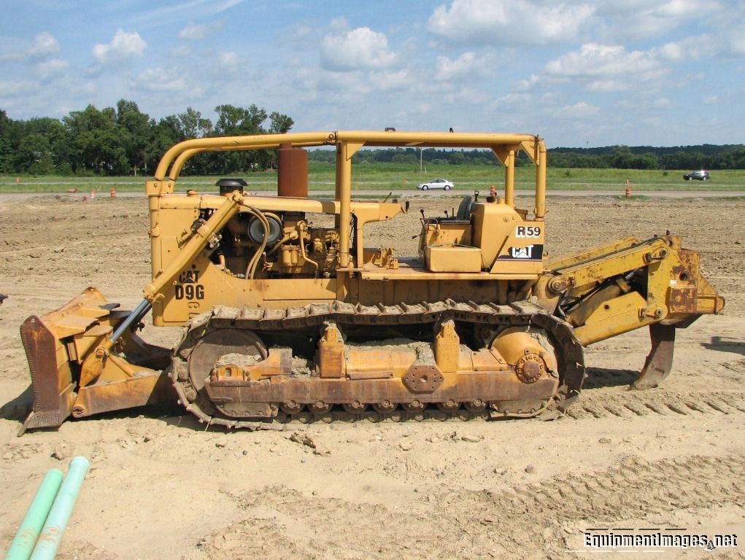
Notes:
The clinkery surface actually covers a massive dense core, which is the most active part of the flow. As pasty lava in the core travels down slope, the clinkers are carried along at the surface. At the leading edge of an aa flow, however, these cooled fragments tumble down the steep front and are buried by the advancing flow. Thus aa flows advance much like the tread of a bulldozer -producing a layer of lava fragments both at the bottom and top of an aa flow.

Slide 49
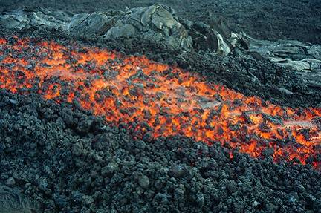
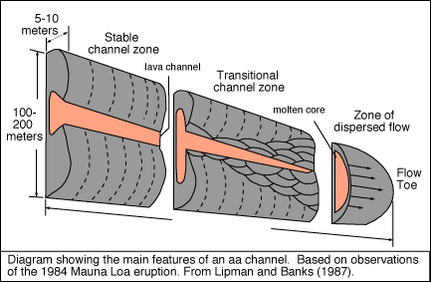
Notes:
Like pahoehoe lava is fed by lava tubes, aa is transported via lava channels. Although aa channels are not completely covered over by solidified lava like lava tubes generally are, the thick accumulations of solidified lava rubble which flank and partly cover aa channels minimize heat loss …

Slide 50
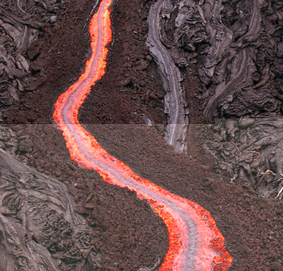
Notes:
… and enable aa to be transported over large distances without solidifying.

Slide 51
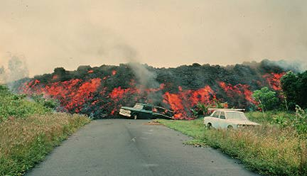
Notes:
Despite aa’s high viscosity, it is capable of moving at speeds sometimes even faster than pahoehoe, because its greater thickness helps gravity spill it forward. The aa flows shown here that surged through the Royal Gardens subdivision from the 1983 Pu’u O’o eruption were up to 36 feet (11 m) thick and moved at rates as great as 108 ft/min (33 m/min). Note the exposed molten core of the flow and vehicles for scale.

Slide 52
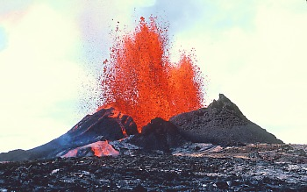
slab
aa
entrail
pahoehoe
smooth
ropy
spiney
Notes:
Although there are many types of pahoehoe, the characteristics of aa are remarkably consistent.

Slide 53
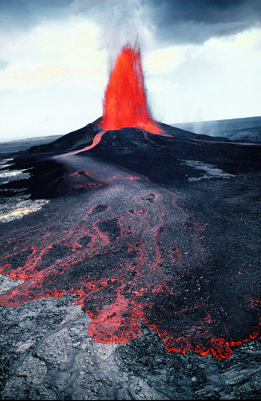
strain
thickening
strain
thickening
Notes:
This is because strain from flowage and fountaining causes pahoehoe to thicken into aa and the thicker the lava the more strain will be induced upon motion. So a positive feedback loop is established in aa between strain and viscosity which irreversibly leads to the formation of aa. How that happens exactly on the molecular level I could not determine, but I envision (with great uncertainty!) that strain forces silica tetrahedrons (the basic structural unit of silicate minerals) to link together and thereby thicken the lava.

Slide 54
High strain transition to aa
aa
pahoehoe
Notes:
If the rate of strain is high, the transition threshold between pahoehoe and aa is reached at a lower viscosity than if the shear strain rate is low.

Slide 55
Notes:
This is the type of thing that happens when effusion rates are high such as with vigorous fountaining, …

Slide 56
pahoehoe
aa
Notes:
… or when pahoehoe pours over a cliff. Catching the incipient transition from pahoehoe to aa is a rare and fascinating event,

Slide 57
Notes:
… but not worth risking your life for.

Slide 58
pahoehoe
aa
Notes:
Here you can actually see the transition taking place almost instantaneously as this pahoehoe flows over a steep slope. The area outlined in red is shown in the next photo …

Slide 59
Notes:
… where you can see how the lava has lost its elasticity and is beginning to be ripped apart into clinkers.

Slide 60
aa
High viscosity transition to aa
pahoehoe
Notes:
The converse is also true. If the viscosity of the lava is high, a relatively low rate of shear strain may achieve the transition threshold, and the lava changes to aa. For example, a slow-moving pahoehoe flow that has cooled sufficiently may transform into aa as the flow continues to advance.

Slide 61
Notes:
There are many other fascinating lava features that deserve mention like lava trees, …

Slide 62
Notes:
… and lava balls …

Slide 63
Notes:
… but a huge part of the enjoyment of Hawaiian Volcanoes National Park …

Slide 64
Notes:
... comes from making your own discoveries!

Slide 65
A’a flow from Pu’u O’o in Royal Gardens subdivision 7/15/83
Notes:
Photograph by J.D. Griggs on July 15, 1983`A`a flows from Pu`u `O`o cut across the streets of Royal Gardens subdivision. This residential area was built on Pulama pali, the steep slope between the east rift zone and the coastal plain.

Slide 66
Channeled a’a flow from Pu’u O’o 10/5/83
Notes:
Photograph by R.W. Decker on October 5, 1983A channeled `a`a flow from Pu`u `O`o cuts a swath through the forest. The characteristic rough, blocky surface of cooled `a`a is visible at the margins f the flow. The river of lava inside the channel travels much faster than the flow actually advances. This is because the lava river fans out at the terminus of the flow and slows as its margins cool.

Slide 67
Peterson and Tilling (1980, p. 273) suggested two general conditions that determine whether pahoehoe or aa forms:
If lava slows, cools, and stops in direct response to the corresponding increase in viscosity only, it retains its pahoehoe form.
If lava is forced to continue flowing after a certain critical relationship between viscosity and rate of shear strain is achieved, the lava changes to aa.
If the rate of shear strain is high, the transition threshold is reached at a lower viscosity than if the shear strain rate is low. The converse is also true. If the viscosity of the lava is high, a relatively low rate of shear strain may achieve the transition threshold, and the lava changes to aa.
Notes:
Peterson, D.W., and Tilling, R.I., 1980, Transition of basaltic lava from pahoehoe to aa, Kilauea Volcano, Hawaii: field observations and key factors: Journal of Volcanology and Geothermal Research, v. 7, p. 271-293.

Slide 68
Notes:
Pahoehoe is often converted to a'a as lava advances downslope, away from the volcano. Conversion of a'a to pahoehoe, on the other hand, never takes place. The pahoehoe-to-a'a conversion can be caused by either an increase in flow viscosity, or an increase in the rate of shear. Cooling, gas loss, and crystallization of the lava will cause it to become increasingly more polymerized and viscous as it advances farther downslope. Although the downslope increase in viscosity can convert pahoehoe to a'a, a higher rate of shear can also cause the conversion. Shear increases in flows that have higher effusion rates. A'a begins to form when effusion rates are >5-10 cubic meters per second. The rate of shear can also increase as lava advances down increasingly steeper slopes. This is demonstrated, for example, by the conversion of pahoehoe to a'a in recent lava flows that have advanced down the Hilina Pali escarpment during the ongoing eruption of the Pu'u O'o Volcano, Hawaii.
Figure F1. Controls on the formation of pahoehoe, aa, and transitional lava types, after Peterson and Tilling (1980). Pahoehoe forms when fluid lava is subjected to low strain rates. Aa forms when viscous lava is subjected to high strain rates. Slab pahoehoe is the result of fluid lava subjected to high strain rates, and spiny pahoehoe comes from viscous lava and low strain rates. It is currently unclear where rubbly pahoehoe would plot on this graph.

Slide 69
Notes:
Mauna Ulu 1969

Slide 71
Notes:
Photograph by C. Heliker on 21 May 1998`A`a flows pour down a steep slope on the southeast flank of Kilauea Volcano, Hawai`i, following a brief pause in the eruption of Pu`u `O`o vent. A close-up of the lower right-hand corner of the upper image.Pahoehoe to `a`a transition Nearly all lava in Hawai`i erupts as pahoehoe, and some changes to `a`a during flowage and cooling. The critical factor that determines whether pahoehoe or `a`a forms is the relationship between the viscosity of the lava (resistance to flow) and the amount of internal disturbance or shear that occurs as lava spreads from a vent downslope. Generally, if pahoehoe viscosity is high (relatively cool pasty lava), a low rate of shear or disturbance may cause `a`a to form. For example, a slow-moving pahoehoe flow that has cooled sufficiently may transform into `a`a as the flow continues to advance. If pahoehoe viscosity is low (relatively hot fluid lava), a high rate of shear or disturbance is required for transition to `a`a. For example, when a fluid pahoehoe flow pours over a steep slope, it increases its speed and creates conditions favorable for `a`a to form.
Any factor that increases the viscosity of pahoehoe, such as cooling, loss of gas, or crystallization will favor the transition of pahoehoe to `a`a. Pahoehoe can change to `a`a, but the reverse never occurs.
Pahoehoe can change to aa but aa does not change into pahoehoe. They have the same chemical composition. The change occurs when pahoehoe cools and starts to loose some of its gas. The number of crystals in the flow also increases. Cooling, degassing, and increasing crystallinity increase the viscosity of the lava and, at some critical point, the lava changes from pahoehoe to aa. An increase in velocity, such as a flow moving down the pali , can also cause the transition. High eruption rates can also produce aa lava.

Slide 72
Notes:
Lava trees form where lava flows inundated a forest, leaving standing molds of where some of the trees stood and were incinerated before the surrounding lava drained away. These lava trees are along the edge of a flow near the Mauna Ulu parking area on Chain of Craters Road.

Slide 73
Notes:
Lava trees are relatively common where pahoehoe has buried forests

Slide 75
Notes:
Lava flows near the coast tend to spread out laterally and enter the ocean over a large front. Several lava tubes may be active across the flow front. Larger lava tubes feed down slope and maintain pressure in the growing lobes that extend into the water. Flow lobes develop most readily on steep slopes and result in stacks of pillow "tongues" that parallel the offshore slope. This offshore stack of lava produces beds of rubble parallel to the offshore slope. Geologists call these steeply dipping beds foreset beds.
The foreset beds are part of a lava delta that grows towards the ocean and provides a platform on which subaerial lavas can extend, thus adding new land to the island. However, some lobes are not continuous and break apart to form pillow sacks, thus adding rubble to the flank of the volcano. The active front of a lava delta is called a bench. Like the delta, the bench is built on rubble. However, the bench is relatively unstable and can collapse, falling into the ocean (Mattox, 1993).

Slide 77
Laccolith?
Notes:
Photograph by S.R. Brantley on August 17, 1998
View is from the caldera floor north of Halema`uma`u toward the northwest. In this section of the caldera wall, north of Uwekahuna Bluff and below a section of thin horizontal lava flows, is a massive doubly-humped body of light-colored basalt. It is about 300 m long and 25-30 m thick. An unusually high concentration of olivine crystals in the central and lower parts of the layer (15-40 percent) is evidence that these heavy minerals "settled" to the lower part of the molten-rock lense before it solidifed.What is the source of this massive layer?
Many scientists have interpreted the solidified lava as a laccolith -- a body of molten rock that moved up into the summit area of Kilauea and then forced its way sub-horizontally into a pile of lava flows. In support of this hypothesis, scientists have argued that lava flows on the north (right) edge of the body were lifted over the intruding magma, which would indicate that the flows were deformed sometime after they had been erupted onto Kilauea's surface.Two alternative origins are drawing increased attention. One is that the body was injected laterally from a high-standing lava lake in the caldera. Such bodies were observed on a smaller scale in the walls of Halema`uma`u just after the lava lake drained away in 1924. The second alternative is that the body is a composite of two tumuli in a lava flow. Scientists have observed tumuli as tall as about 15 m develop in the pahoehoe flow field of Kilauea's Pu`u `O`o - Kupaianaha eruption.The range of ideas of how the body formed illustrates a common problem in geology -- how to assign a unique, definite origin to an event that was not observed.In other parts of the west caldera wall, scientists have identified 18 vertically oriented intrusive structures called dikes. The combined width of these dikes is about 15 m and accounts for less than 1 percent of the length of the west wall.

Slide 78
Pu'u Pua'i cinder cone that formed next to Kilauea Iki Crater from 1959 eruption on Kilauea
Notes:
Lava fountains typically build cinder and/or splatter cones, like this cinder cone formed from the 1959 eruption of Kilauea Ike …

Slide 81
Notes:
This striated channel formed on an exposed lava channel. Recent flows extend to the shore of the Pacific Ocean is in the distance

Slide 84
Notes:
View from the northeast edge of Halema`uma`u toward the northeast. A short-lived fissure eruption built this spatter rampart on April 30-May 1, 1982. Three other brief fissure eruptions occurred in this area in May-June 1954, September 1971, and November 1975.
Spatter ramparts are long, narrow ridges of spatter that accumulate along either side of an erupting fissure. The spatter "sticks together" or agglutinates when it lands and is buried by later spatter. If a fissure narrows to a single vent along the original fissure, the spatter may build a taller conical spatter cone, or spatter and cinder cone with a circular base (for example, see growth of Pu`u `O`o on Kilauea's east rift zone).
The light material in foreground consists of minerals formed by reaction of acidic volcanic gas with glass in the spatter and adjacent lava flow.

Slide 86
Notes:
Four main plumes of fume blown southwest from vents in crater of Pu`u `O`o. From near to far, Beehive, Drainhole, January Vent, and East Pond Vent. The cone has collapsed at East Pond Vent, and the vent is now a pit containing a seething lava pond. 1211

